Slide 1

Project Proposal
Sign Language
Smart Home
Digital Vending Machines
Labanya Saha (21201059)
Md Mehedi Islam(21201065)
Jannatun Saumoon (21201066)
Paria Chowdhury (21201067)

Slide 2

Sign Language

Slide 3
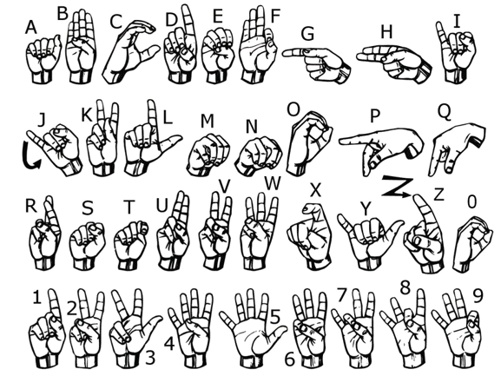
Introduction to Sign Language
Sign language is a visual language that uses hand movements, gestures, body language, and facial expressions to communicate. It is a rich and complex form of communication that is the primary language for many deaf and hard-of-hearing individuals.

Slide 4
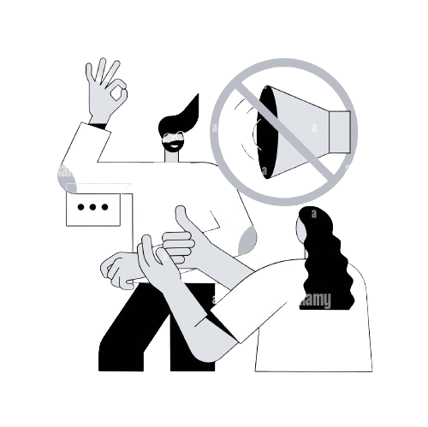
Problem
Our project focuses on creating a model to recognize fingerspelling hand gestures used in American Sign Language (ASL) to form complete words. ASL is the predominant sign language for Deaf and Mute (D&M) individuals who rely on nonverbal communication due to their inability to use spoken languages. Using their hands, D&M individuals convey messages through gestures understood visually. Our goal is to develop a system that accurately interprets these gestures, enabling effective communication between D&M individuals and others.

Slide 5

Motivation
1
Increased Inclusivity
Learning sign language promotes inclusivity and allows individuals to connect with the deaf community more effectively.
2
Professional Opportunities
Sign language skills open doors to careers in interpretation, education, and various support services for the deaf community.
3
Personal Growth
It provides a unique opportunity to broaden linguistic and cultural understanding while fostering empathy and compassion.

Slide 6



Solution
Education
Community Engagement
Accessible resources for learning sign language through courses, apps, and online tutorials.
Participation in deaf community events, social groups, and activities to practice and enhance signing skills.

Slide 7
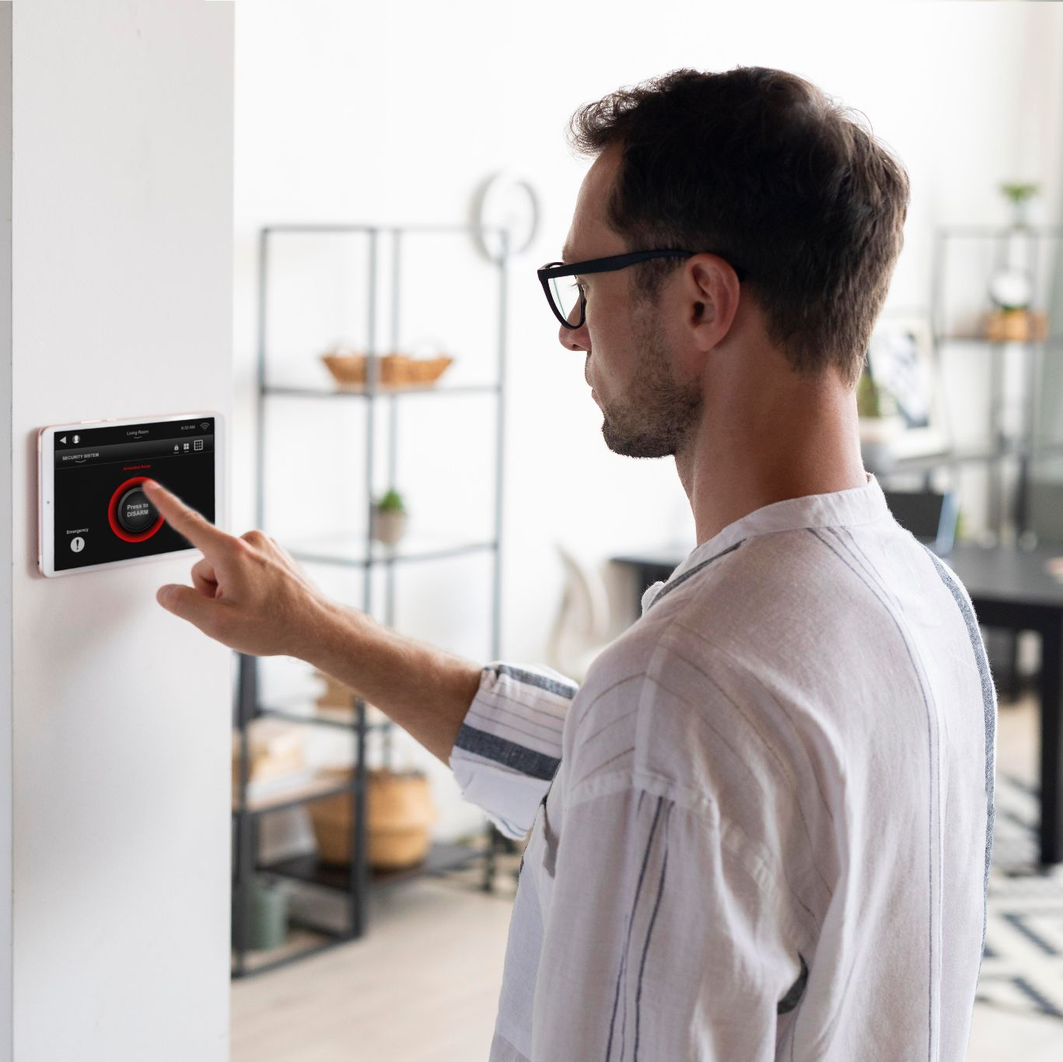
SMART HOME

Slide 8
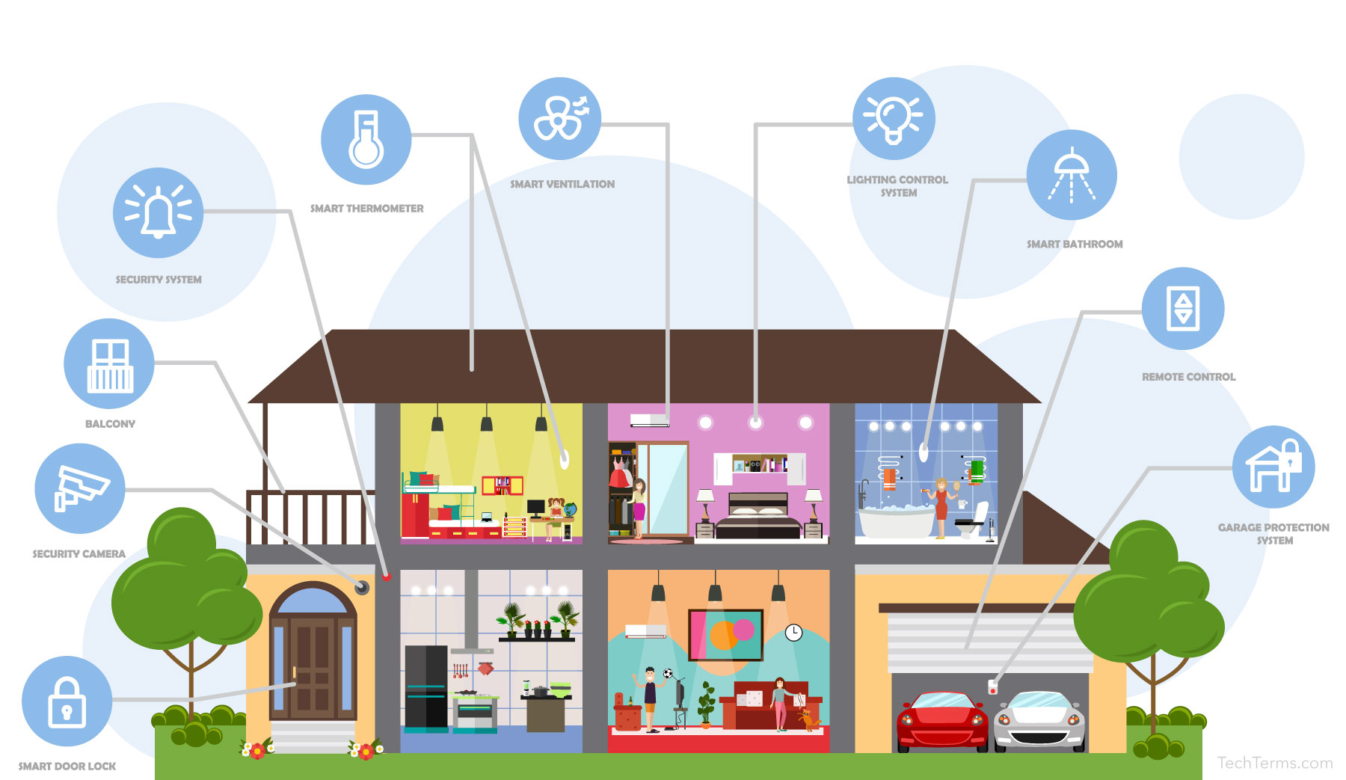
Definition
A smart home is a house equipped with a technology system that can be controlled remotely through a mobile device or computer, enhancing convenience and efficiency in daily living.

Slide 9
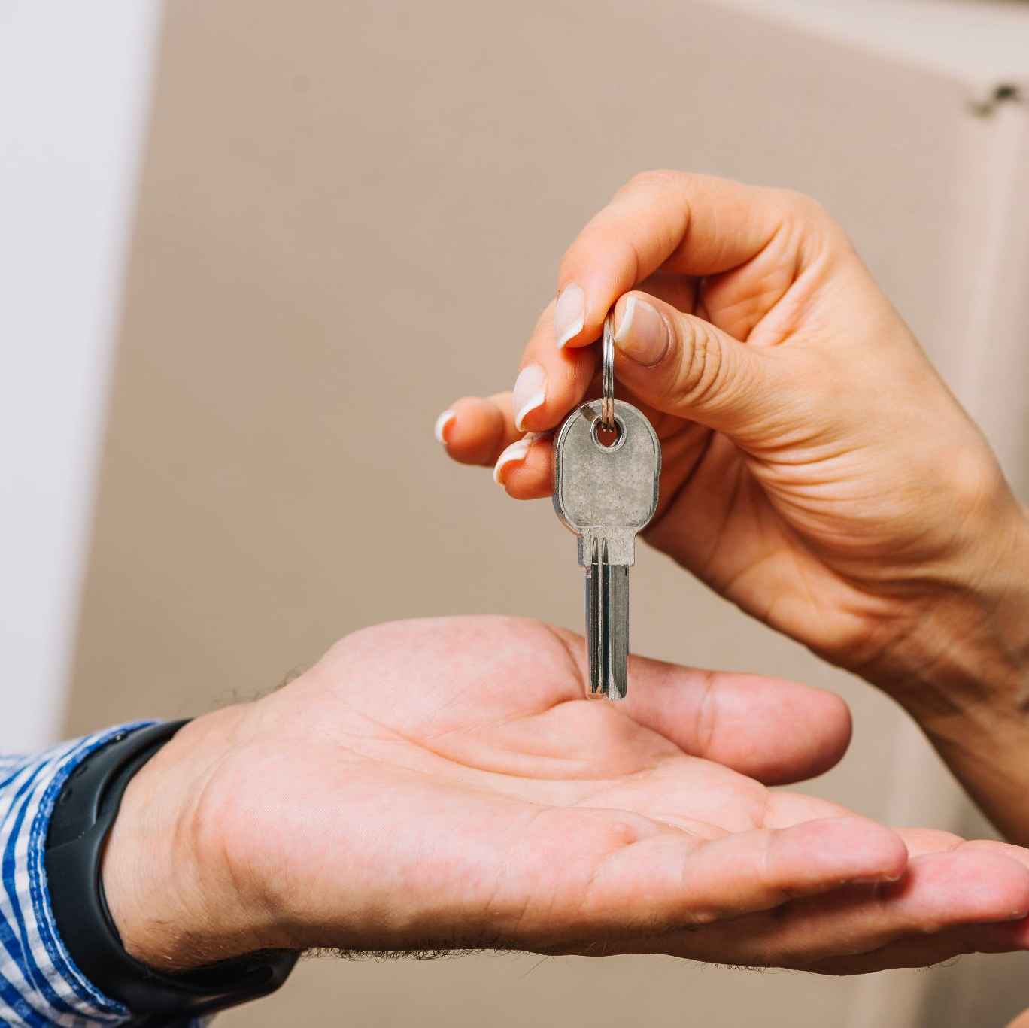
Problem
Typical homes lack automation and connectivity, requiring manual control for functions like lighting, temperature, and security. They are also susceptible to electrical short circuits, gas leaks, and various accidents, making them inconvenient, unsafe, and less energy-efficient.

Slide 10
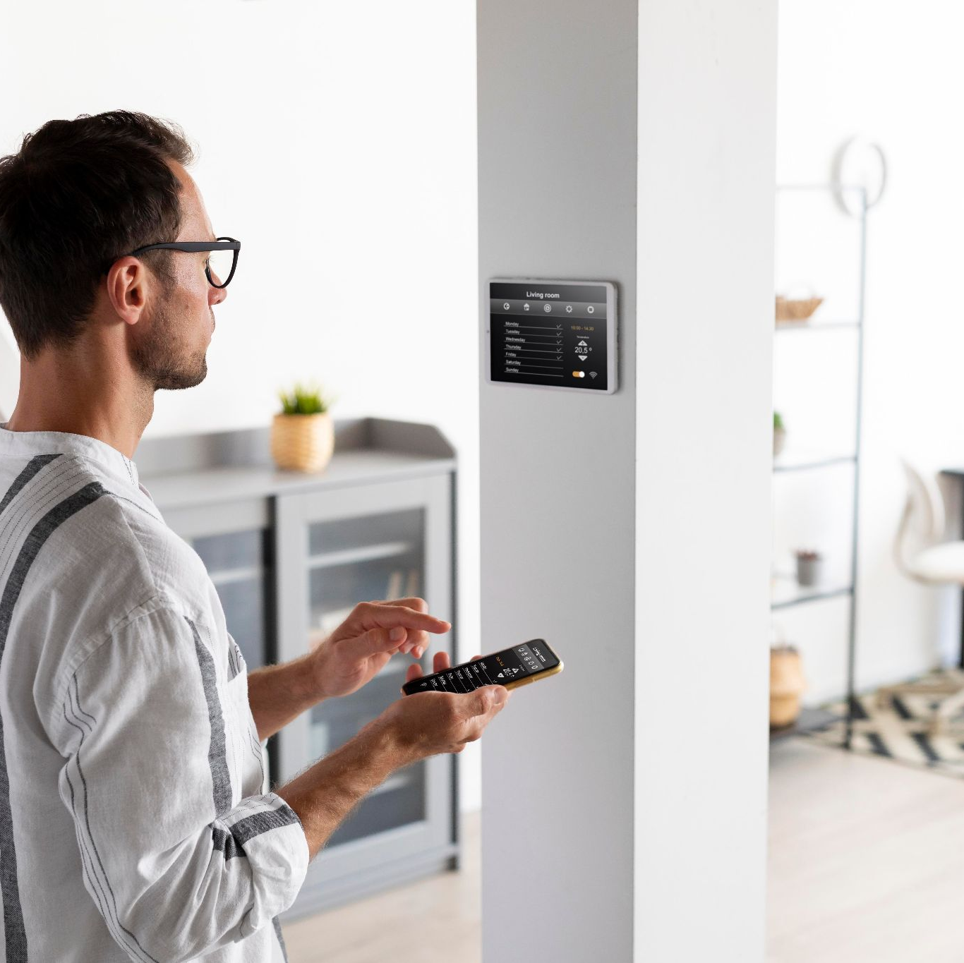
Motivation
People choose smart homes to make daily life more convenient, efficient, and secure. With seamless automation and connectivity, smart homes enable remote control and monitoring of various aspects.

Slide 11
Solution
1- Internet of Things (IoT): Devices equipped with sensors and connectivity enable communication and automation.
2.Home Automation Systems: Centralized systems to control lighting, climate, security, and entertainment.
3. Smart Assistants: Voice-activated systems like Amazon Alexa or Google Assistant for hands-free control.
4.Smart Sensors: Monitoring sensors for security, occupancy, and environmental conditions.
5.Smart Appliances: Devices that can be controlled and monitored through a network.
6. Energy Management: Efficient use of energy through automated control of lighting, heating, and cooling systems.
7.Security Systems: Smart cameras, alarm system, doorbell cameras, and smart locks for enhanced home security.

Slide 12
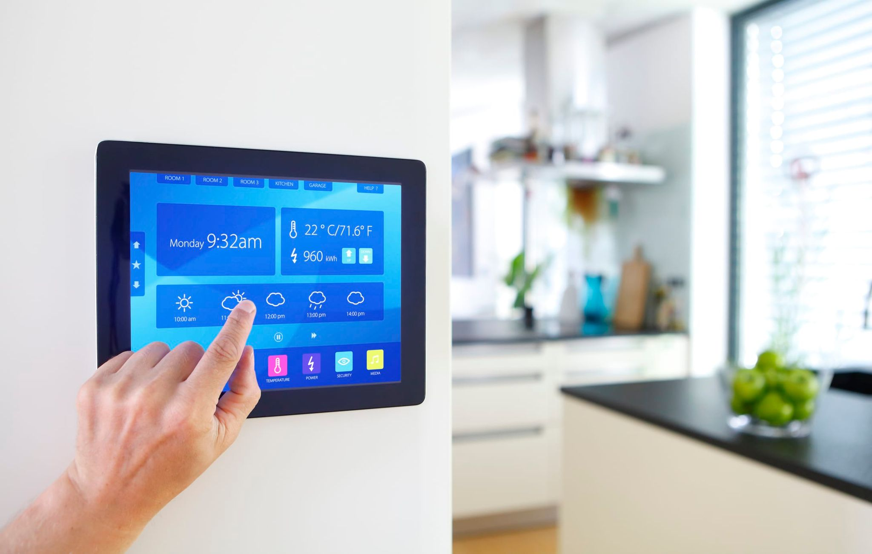
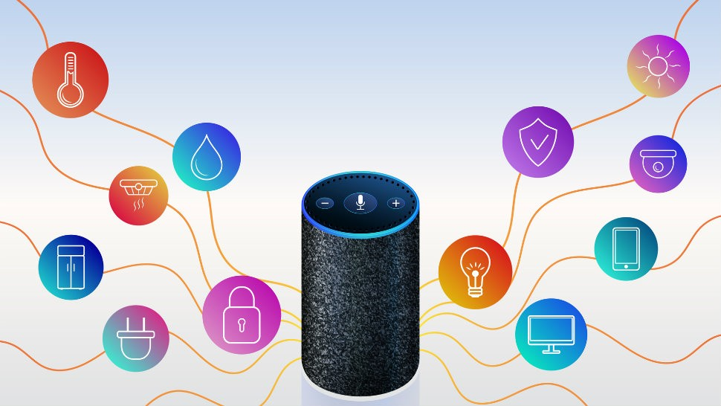
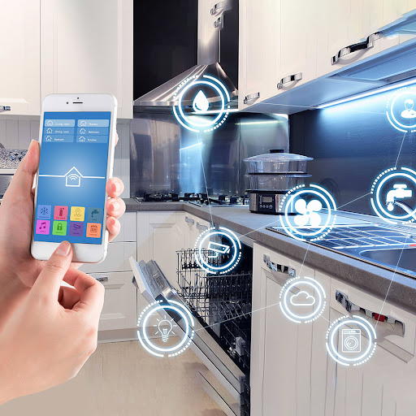

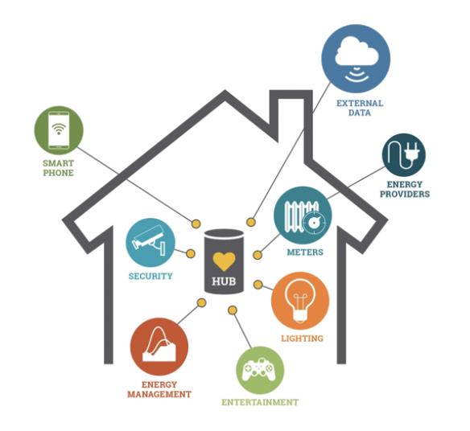

Smart Assistants
Smart Appliances
Home Automation Systems
Internet of Things (IoT)
Security Systems
smart Sensors & energy Management

Slide 13


Digital Vending Machines

Slide 14
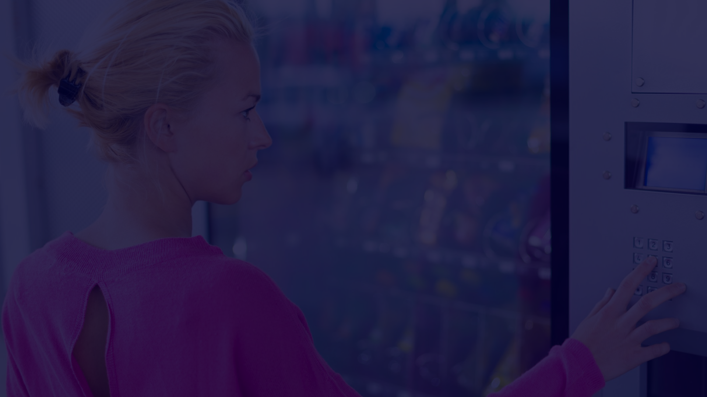
Defination
Problem
A vending machine is an automated machine that dispenses items such as snacks, beverages, cigarettes, and lottery tickets to consumers after cash, a credit card, or other forms of payment are inserted into the machine or otherwise made . Digital vending machines are modern , automated solution that offer convenience and accessibility to consumers.
Vending machines in places like shopping malls and universities offer convenience, quick access to snacks, and a variety of products without the need for interaction. They save space and are strategically located for easy accessibility in busy areas, providing a hassle-free solution for on-the-go needs.

Slide 15
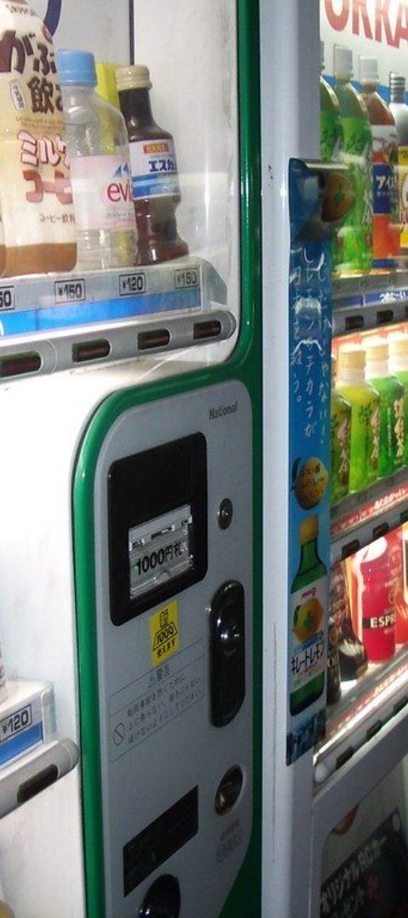
Motivation
Low Overhead Costs.
Easy Maintenance &
management
Keeps Employees Happy.
Improves Team Productivity.
Employees Stay On-Site.
Customizable Options.
Promotes Health & Wellness.
Quick & Easy Access.

Slide 16
Solution
360 Service;
Card Payments;
360 Service: Full-service vending solutions including delivery, installation, restocking, and maintenance.
All machines accept contactless payments including Apple/Samsung Pay.
Vending Options:
Wide range of machines available, from coffee to s Offers.

Slide 17
Thank you

